Slide 1
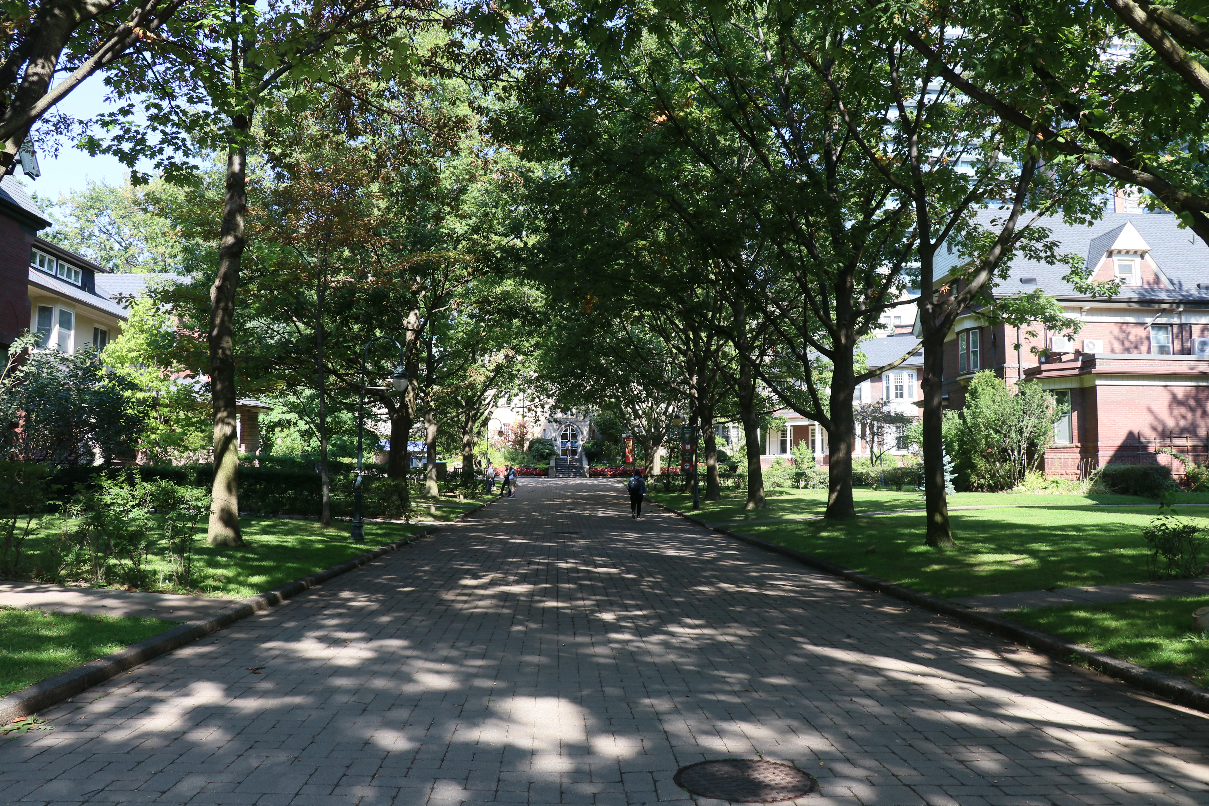

Business Case for the
Diploma in Social Responsibility & Sustainability
Learning with Purpose
2025
Collegium Retreat | 22 February 2020

Slide 2
The Business Case
Over the last 25 years, graduates say this program has been transformational for their careers and companies. Here are some of the factors that support the business case for participating in this program:
Program with a Proven 25 Year Track Record
Recognized, Post-Graduate University Diploma (Dipl. SR&S) & Credential from the University of St. Michael’s College in the University of Toronto
Curriculum Evolves with ongoing Changes in Regulations, Standards and Frameworks
Learn from “Thought-Leader” Practitioner Instructors
Tackle a Company Business Challenges
Complete a Practical, Mentored Capstone Project
12-month Mentorship with a Professional
Participants Fast Track their Sustainability, ESG & Social Impact Competencies
International Changemaker Community
Blended Delivery supports Work/Education/Life balance
Interdisciplinary Approach creates well rounded Sustainability/ESG/Social Impact Leaders

Slide 3
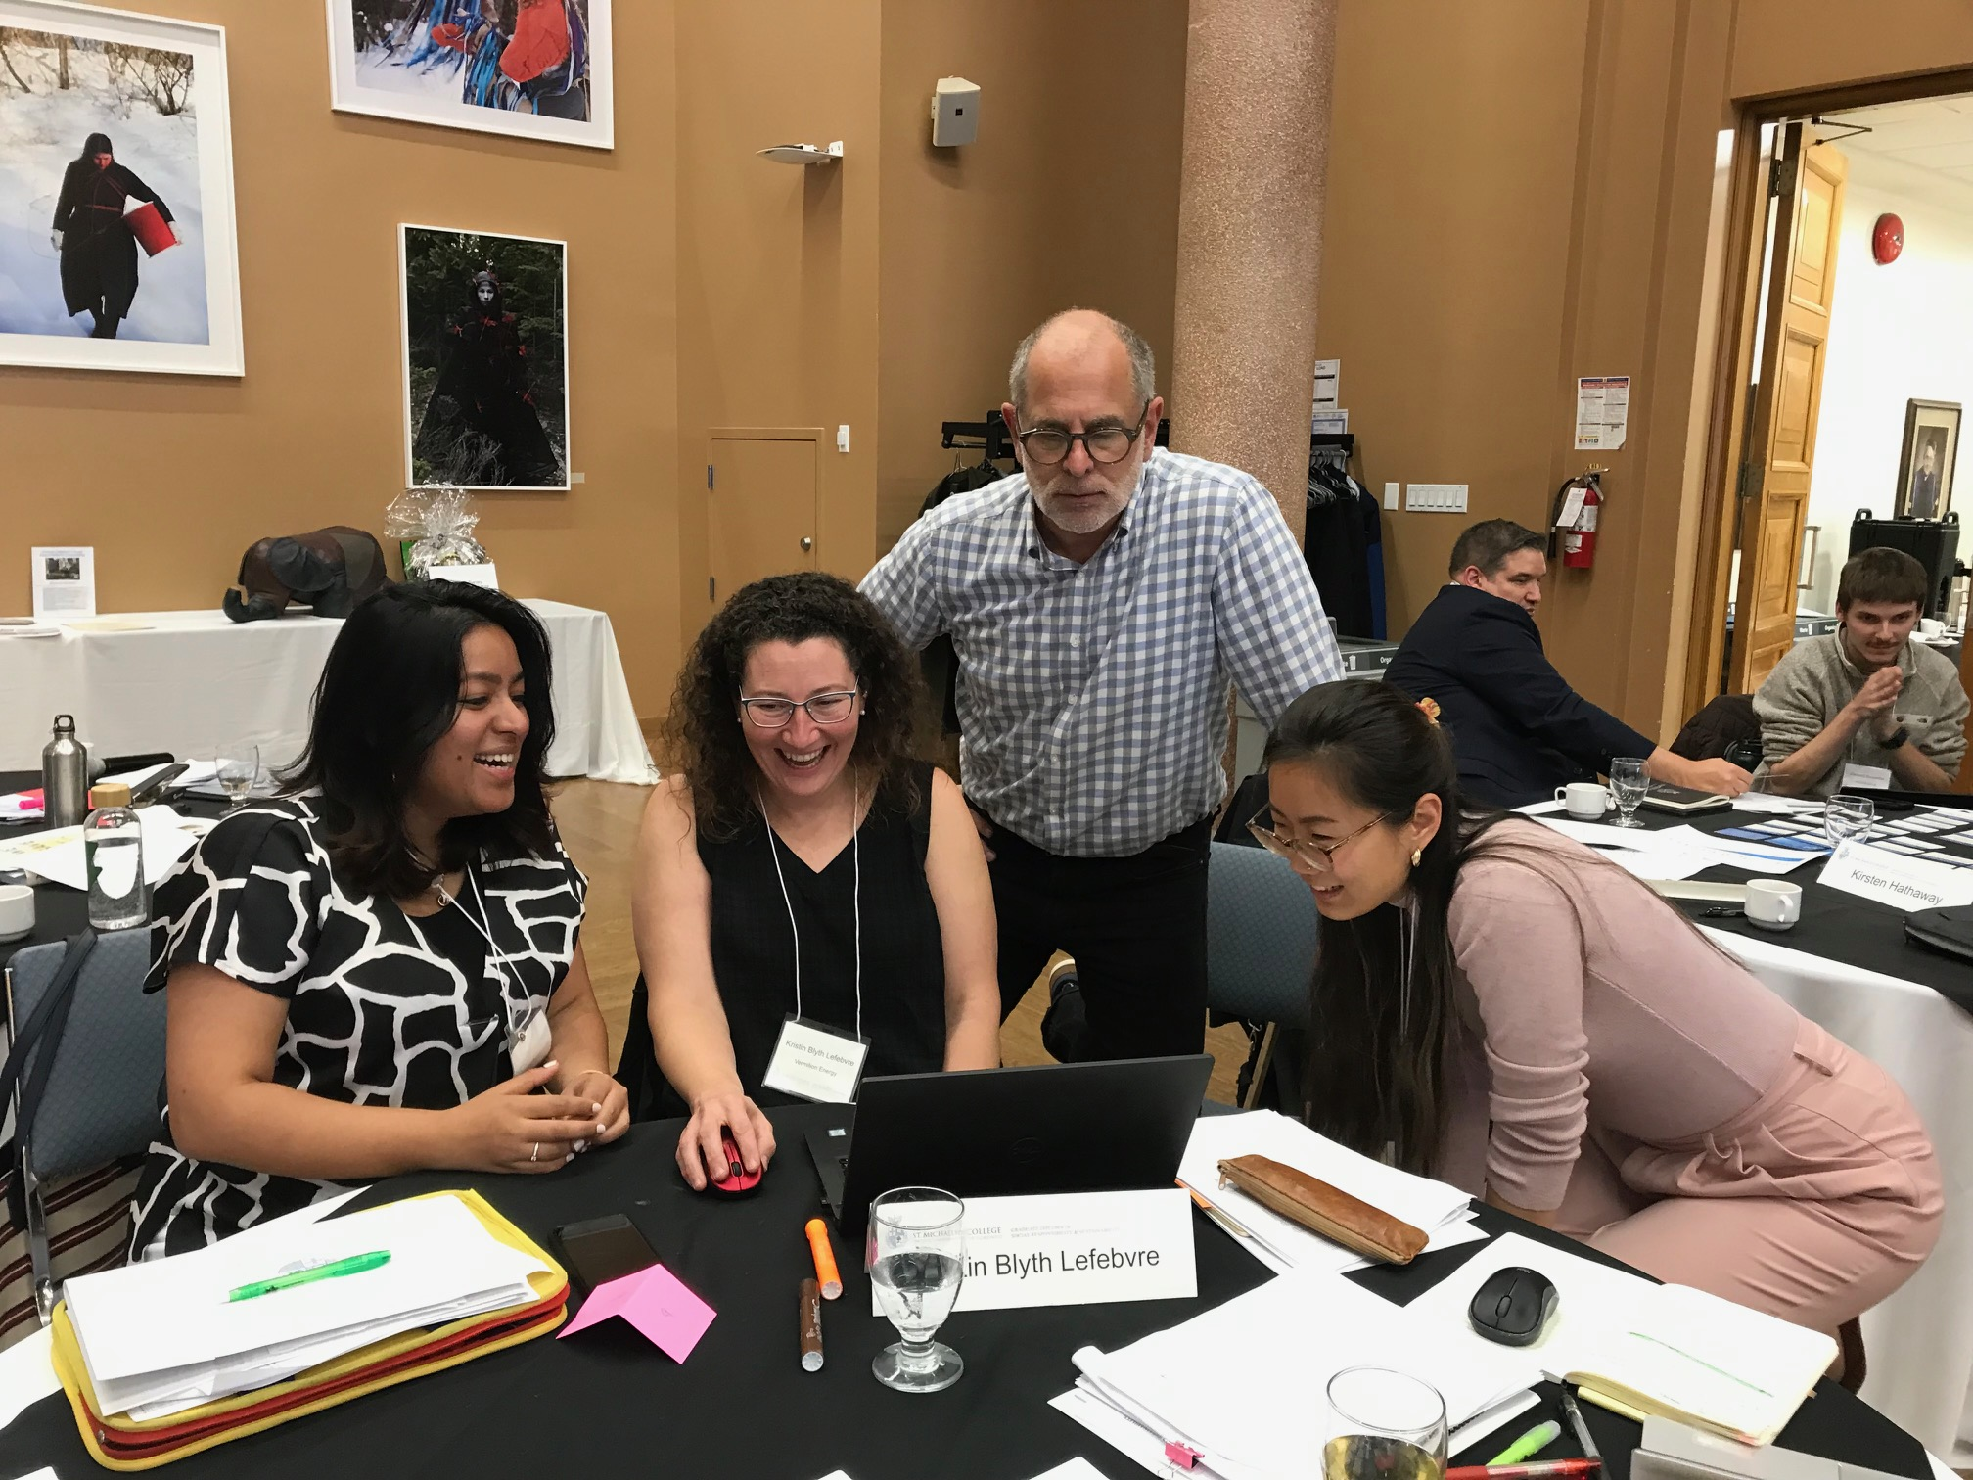
Program with a Proven 25 Year Track Record
This program has emerged as the preferred program for companies seeking to hire sustainability, ESG and social responsibility professionals for the following reasons:
Leading “Work as you Learn” Program
Blend of Practice and Theory - “Thought leader” Practitioner Instructors with Subject Matter Expertise
1:1 Mentorship with Experienced Practitioners
5x more Instructor &Peer contact time than any other educational program in this field
Flexible completion – 16 mo. to 3 years
Tuition Payment Options
Extensive Alumni Network
Practical tools to assess, measure and integrate CSR & Sustainability, ESG
Interdisciplinary approach that connect to values, ethics, business, environment & social impact.
Change Management, Ethics and Climate Simulations

Slide 4
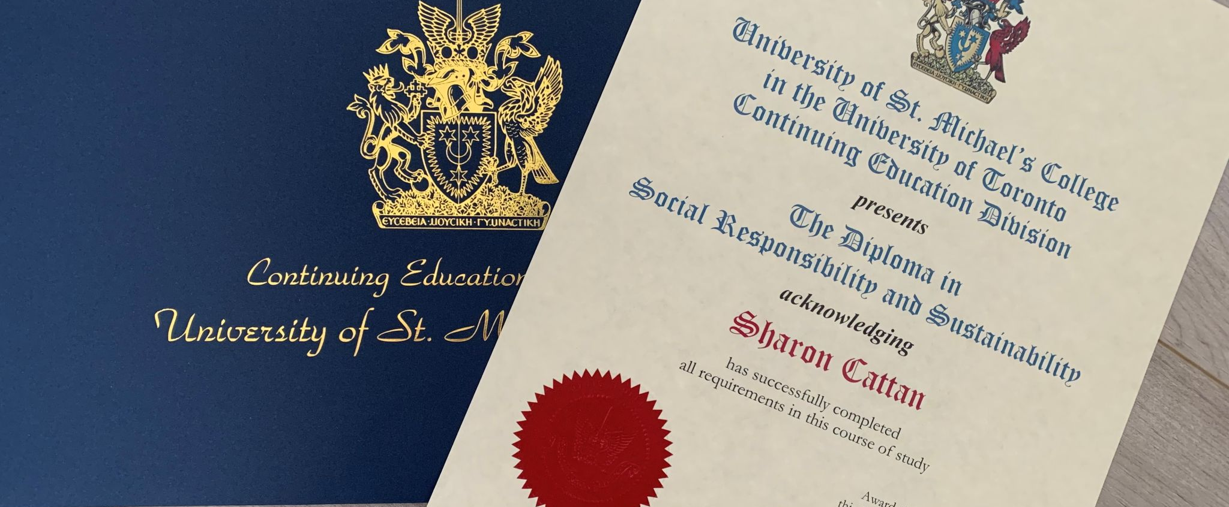
Recognized, Post-Graduate University Diploma (Dipl. SR&S) & Credential
Add post-nominal letters (Dipl. SR&S) after your name…

Slide 5
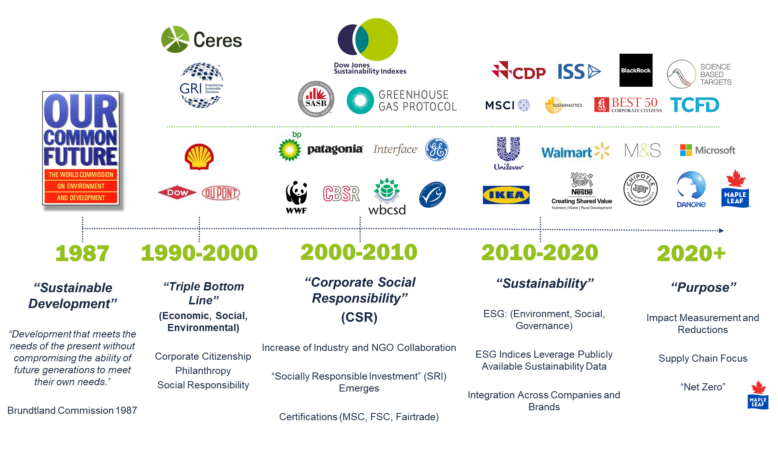
Curriculum Evolves with ongoing Changes in Regulations, Standards and Frameworks

Slide 6
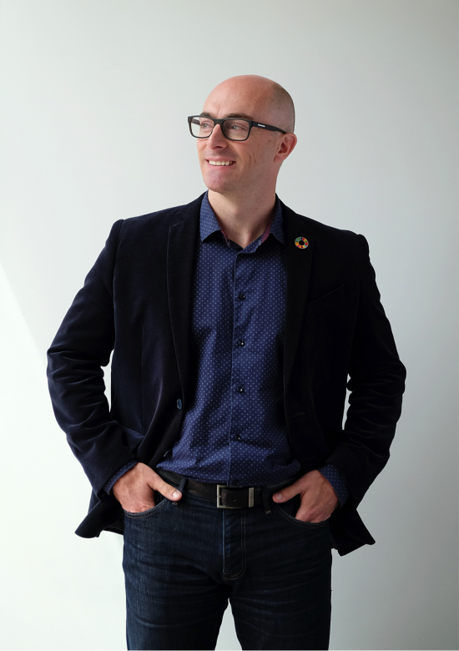
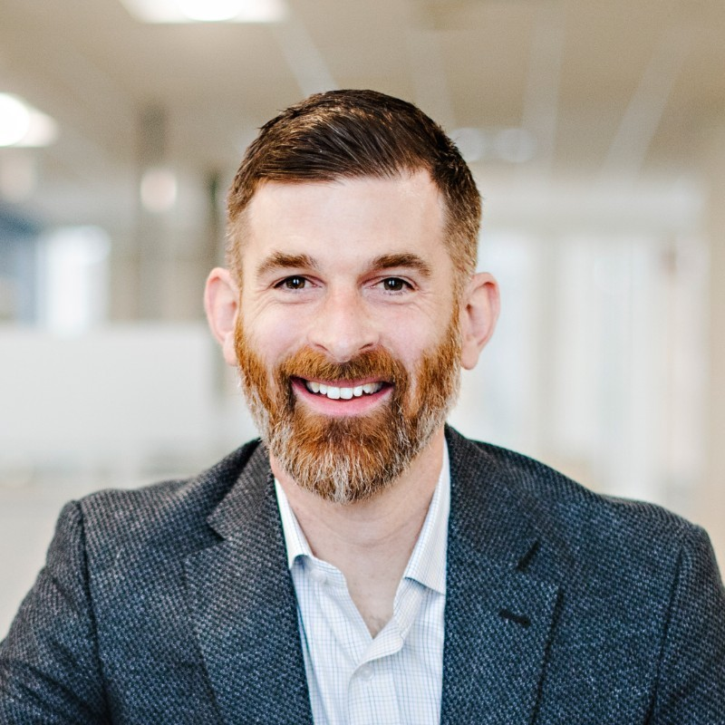
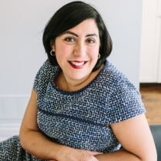
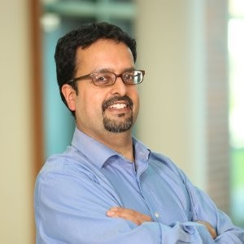
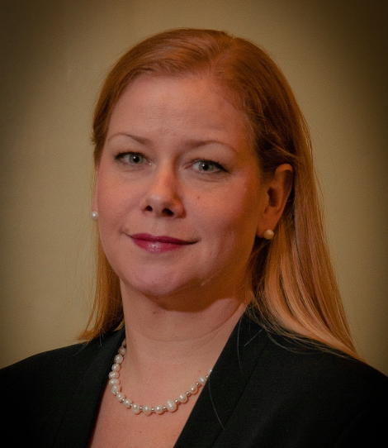
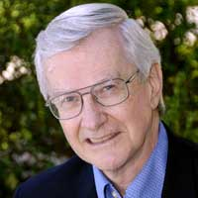
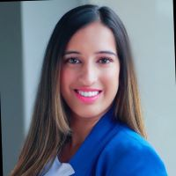
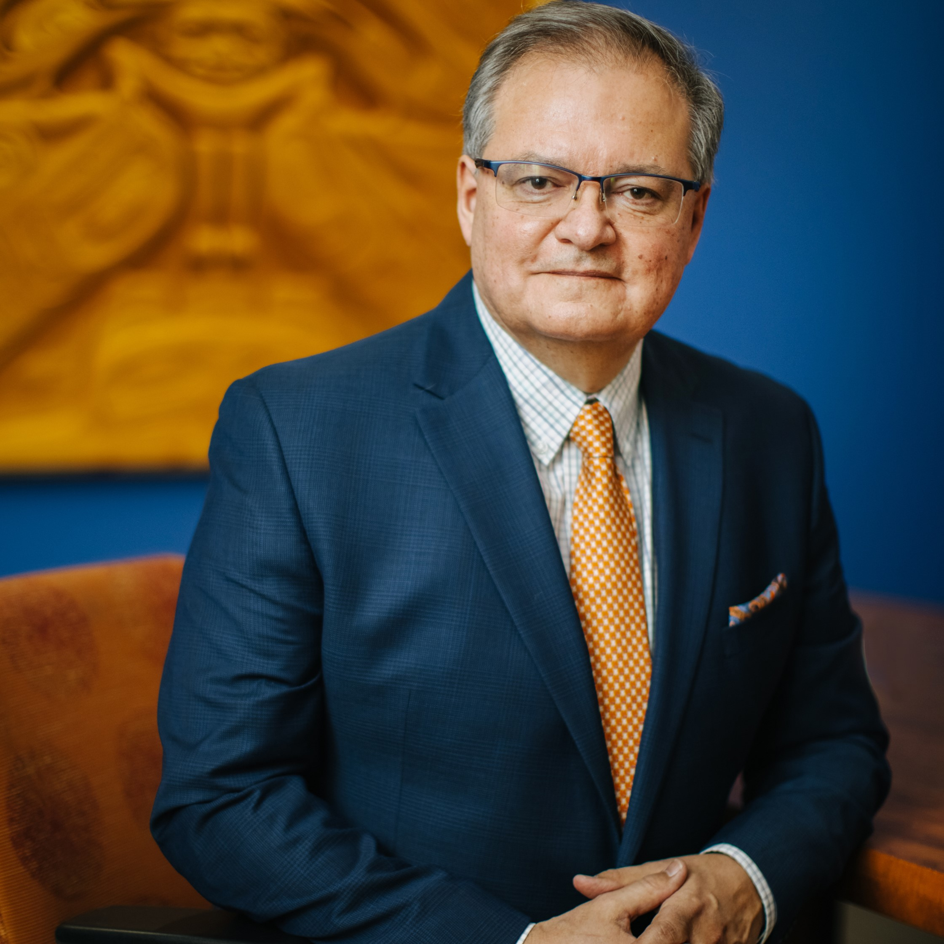
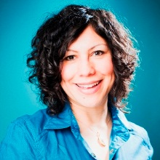
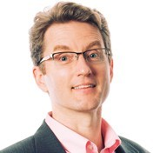
Learn from “Thought-Leader” Practitioner Instructors
BRENDAN SEALE, AVP & Head, Environmental, Social and Governance, Definity
GABRIELA POLANCO-SORTO, Head, Purpose and Sustainability, Gore Mutual Insurance
NEIL SAINANI, Principal, NSG Assoc.
CATHY GALLAGHER-LOUISY, President, CGL Consulting
Dr. Bob Willard,
Ex. IBM, Author,
Consultant, Changemaker
Wes Gee, Chief Sustainability Officer and Co-Founder, the Works Design
PRABH BANGA, Vice-President, Sustainability, AECON Group Inc.
MIKE DEGAGNE, CEO, Indspire
NADINE GUDZ, Global Director, Sustainability Strategy, Interface (formerly)
Dr. RAYMOND PAQUIN, Professor, Concordia University - John Molson School of Business

Slide 7
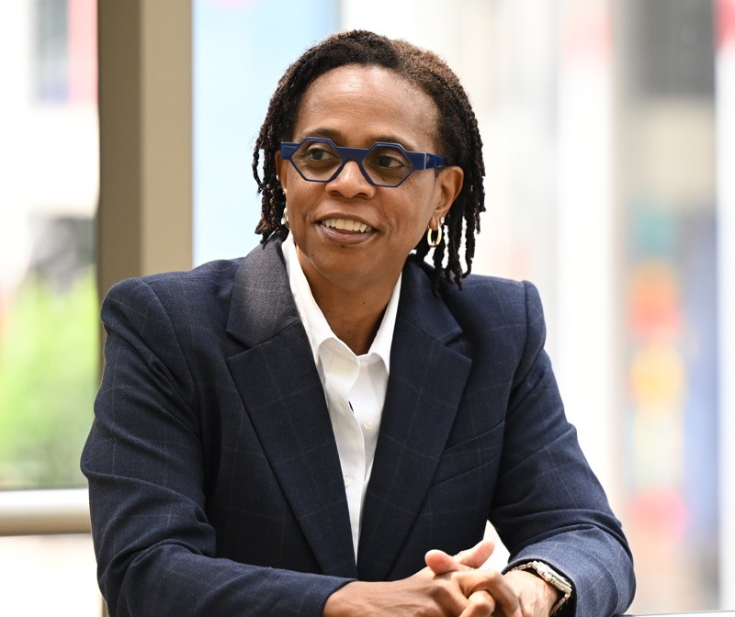
Tackle a Company Business Challenge
Participants in the Program have completed the following Mentored Capstone Projects -
Complete a Materiality Assessment of your Organization
Develop an ESG/Sustainability Strategy or Report
Create a Rubric to evaluate Net Zero in Asset Management Firms
Implement Circularity
Leverage Risk Data to enable effective Communication of ESG
Evaluate Climate Risk and Resilience Management
Embed Diversity, Equity & Inclusion Strategies
Catherine Meade, Vice President – Community, Sustainability & Social Responsibility, OLG
CAPSTONE – OLG Sustainability Strategy

Slide 8
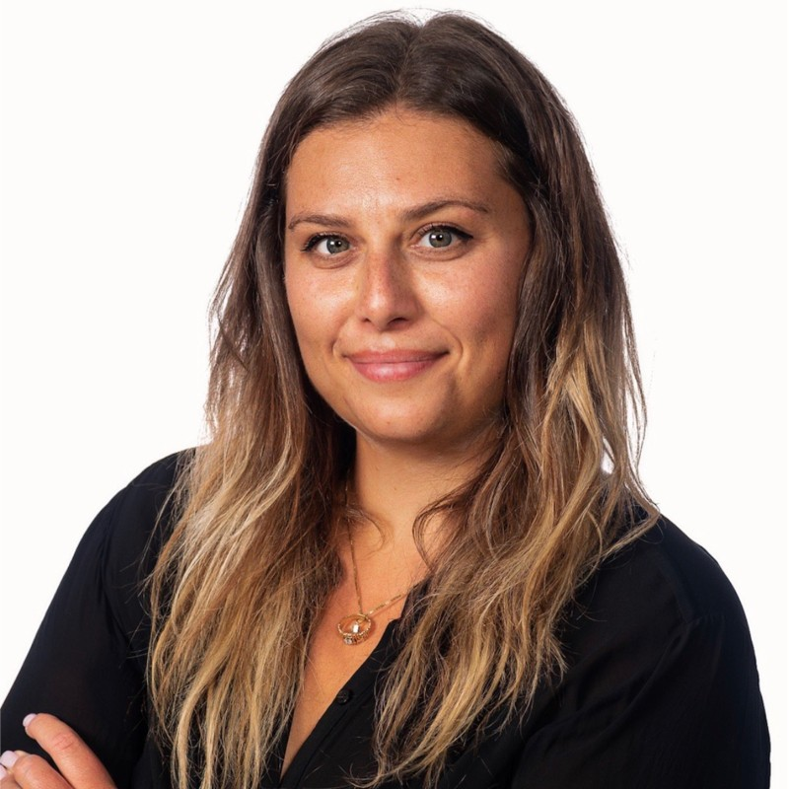
Complete a Practical, Mentored Capstone Project
"For my Capstone Project, I developed the 'Case for a Pardons Ecosystem' to address the crippling systemic barriers to success, which previously incarcerated Black youth face." Kate Gardner, Manager, Strategic Communications, Loyalist College & Co-Founder myRESET
Your topic is specific to your organization, here are a few of the past topics:
Creating a sustainability/ESG report
GHG Scope 3 Footprint Tool
Inclusion Internship Program
Sustainability/ESG Strategy
Truth & Reconciliation Plan
Diversity, Equity & Inclusion Strategy
Community Investment Strategy

Slide 9
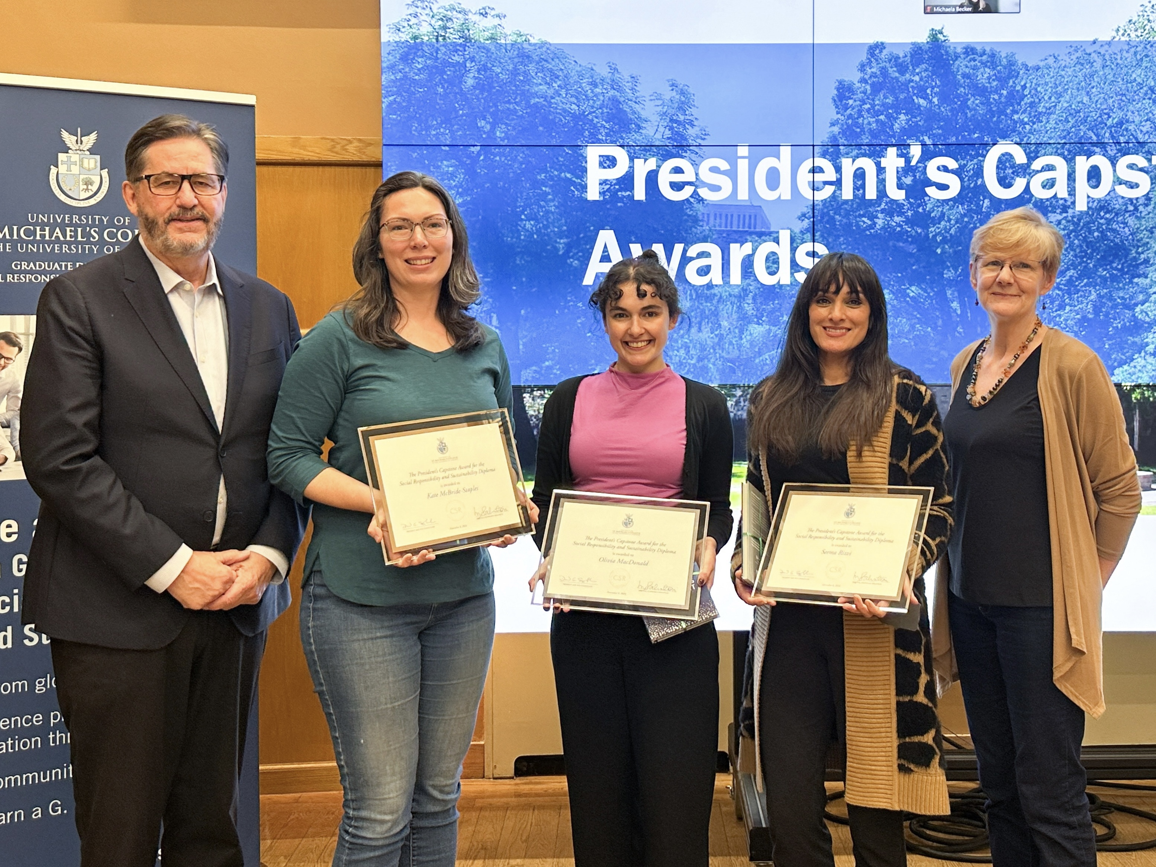
12-month Mentorship Professional Guidance
Mentors are experienced practitioners that support the Capstone Project: Mentors include:
Michael Torrence, Chief Sustainability Officer, BMO
Yvonne Jeffery, VP Sustainability, Vermillion Energy
Rachel Gutherie, VP Sustainability EDC
Shawna Peddle, Assoc. VP Citizenship, The Co-operators
Uzair Jaffer, Director, ESG Reporting and Engagement, Four Seasons Hotels and Resorts
Shahin Hirji, Principal - Sustainability and ESG, Optimize Group Inc.
Brian Shurman, Senior Manager, Citizen Engagement, RBC
Receive recognition through the President’s Capstone Awards

Slide 10
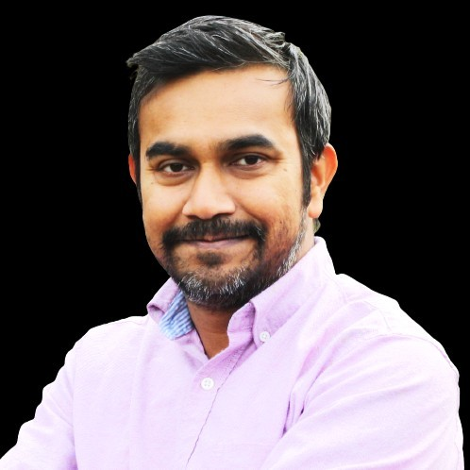
Participants Fast Track their Sustainability, ESG & Social Impact Competency
Graduates have advanced their careers to:
Vice President, ESG & Sustainability
Vice President, Corporate Citizenship
Vice President, Engagement & Sustainability
General Counsel and VP ESG
Director, Climate and Energy
Director, Climate Solutions
Manager, Social Impact and Sustainability
Community Investment Specialist
Manager, Sustainability
“The skills I gained from my Capstone & Internship helped me land an ESG role with a corporate sustainability consultancy - all before graduating," Adnan Zaman, Social Performance Superintendent Social Performance Superintendent, Newmont Corporation (Class 2020/21)

Slide 11
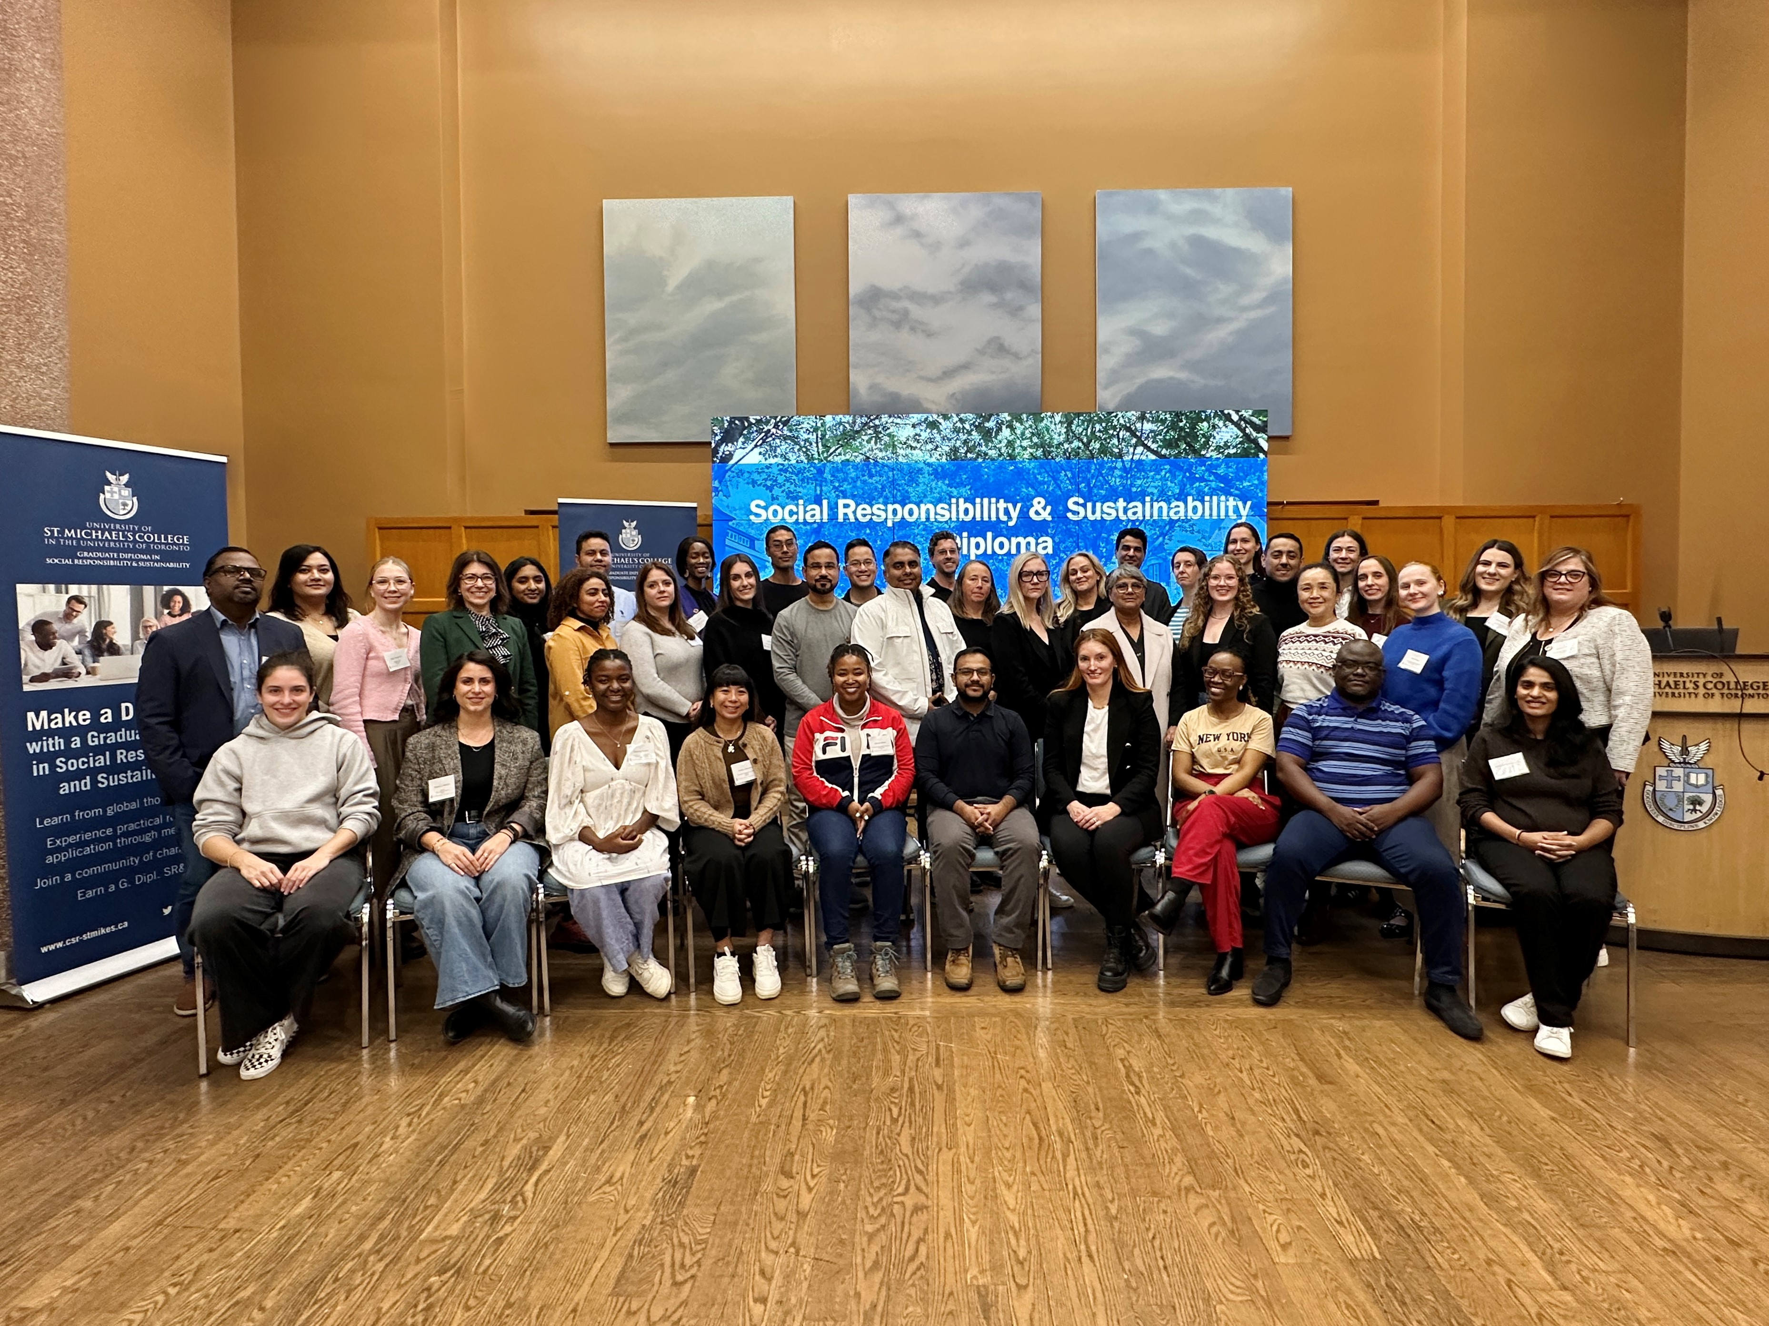
International Changemaker Community
Network with 20 years of like-minded colleagues to share best practices.
Learn innovative approaches from changemakers in other sectors and countries.
Get Inspired by people with a passion to be a “force for good”.
Build a lasting relationship with “Thought-leader” Mentors, Practitioners & Instructors.
Make friends for life.
Graduates come from 8 Countries within 19 Sectors, in both the For Profit and Not For Profit sectors

Slide 12
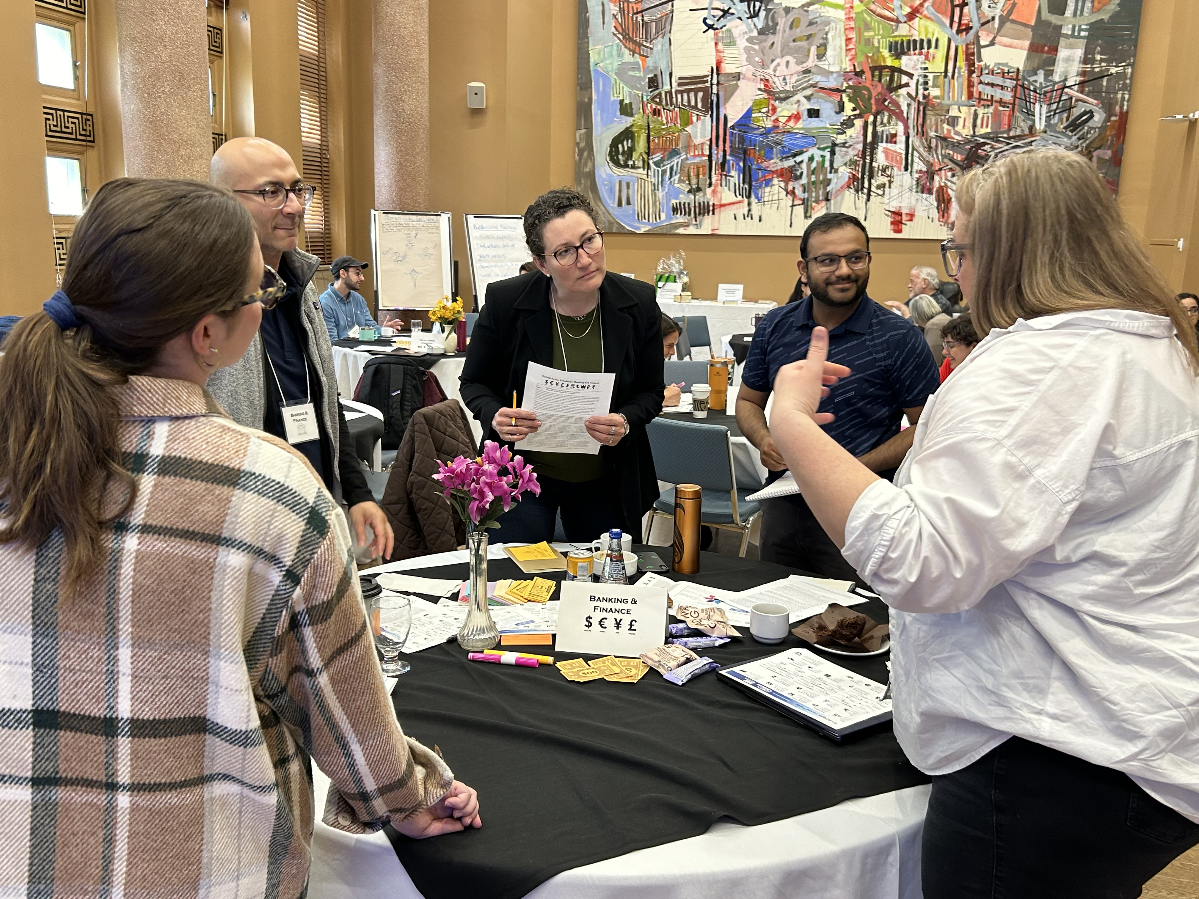
Blended Delivery supports Work/Education/Life Balance
1. In-Person (11 days)
3 Sessions (Foundations, 3 days, Application, 5 days, Embedding, 3 days)
2. Synchronous Online (accumulated 30 days)
Web Lectures every 2 weeks
Group Projects
Mentorship
3. Asynchronous Online
Self Directed Learning on LMS – reading, videos and posts
2 Assignments, 1 Capstone
Group Projects on 3-Horizons, Business Models and Reporting

Slide 13
Interdisciplinary Approach creates well rounded Sustainability/ESG/Social Impact Leaders
Module 1: Establishing the Foundation
Business Case & State of Sustainability, SR & ESG
Managing Change
Module 2: Practical Application
Strategy & Embedding, Goal Setting & Position Statements
Climate Change Mitigation Simulation (MIT)
Module 3: Advancing Organizational Embedding
Governance Best Practices & Assessment
Truth & Reconciliation (Context, Truth & Reconciliation Plans, Progressive Aboriginal Relations)
T&R Kairos Blanket Exercise
TBL Business Models
Community Investment Strategy
Ethics
Allyship & Diversity, Equity, Inclusion & Accessibility Assessment
Reporting, Ratings, Rankings
Transitional Leadership
Global Trends in ESG & Sustainability Standards & Reporting Session
Leadership for Sustainability, SR & ESG
Resilience in Leadership
Plus Online Lectures
Plus Online Lectures
Plus Online Lectures
See our Website for the Full List of Course Topics: https://www.csr-stmikes.ca/program-info/

Slide 14
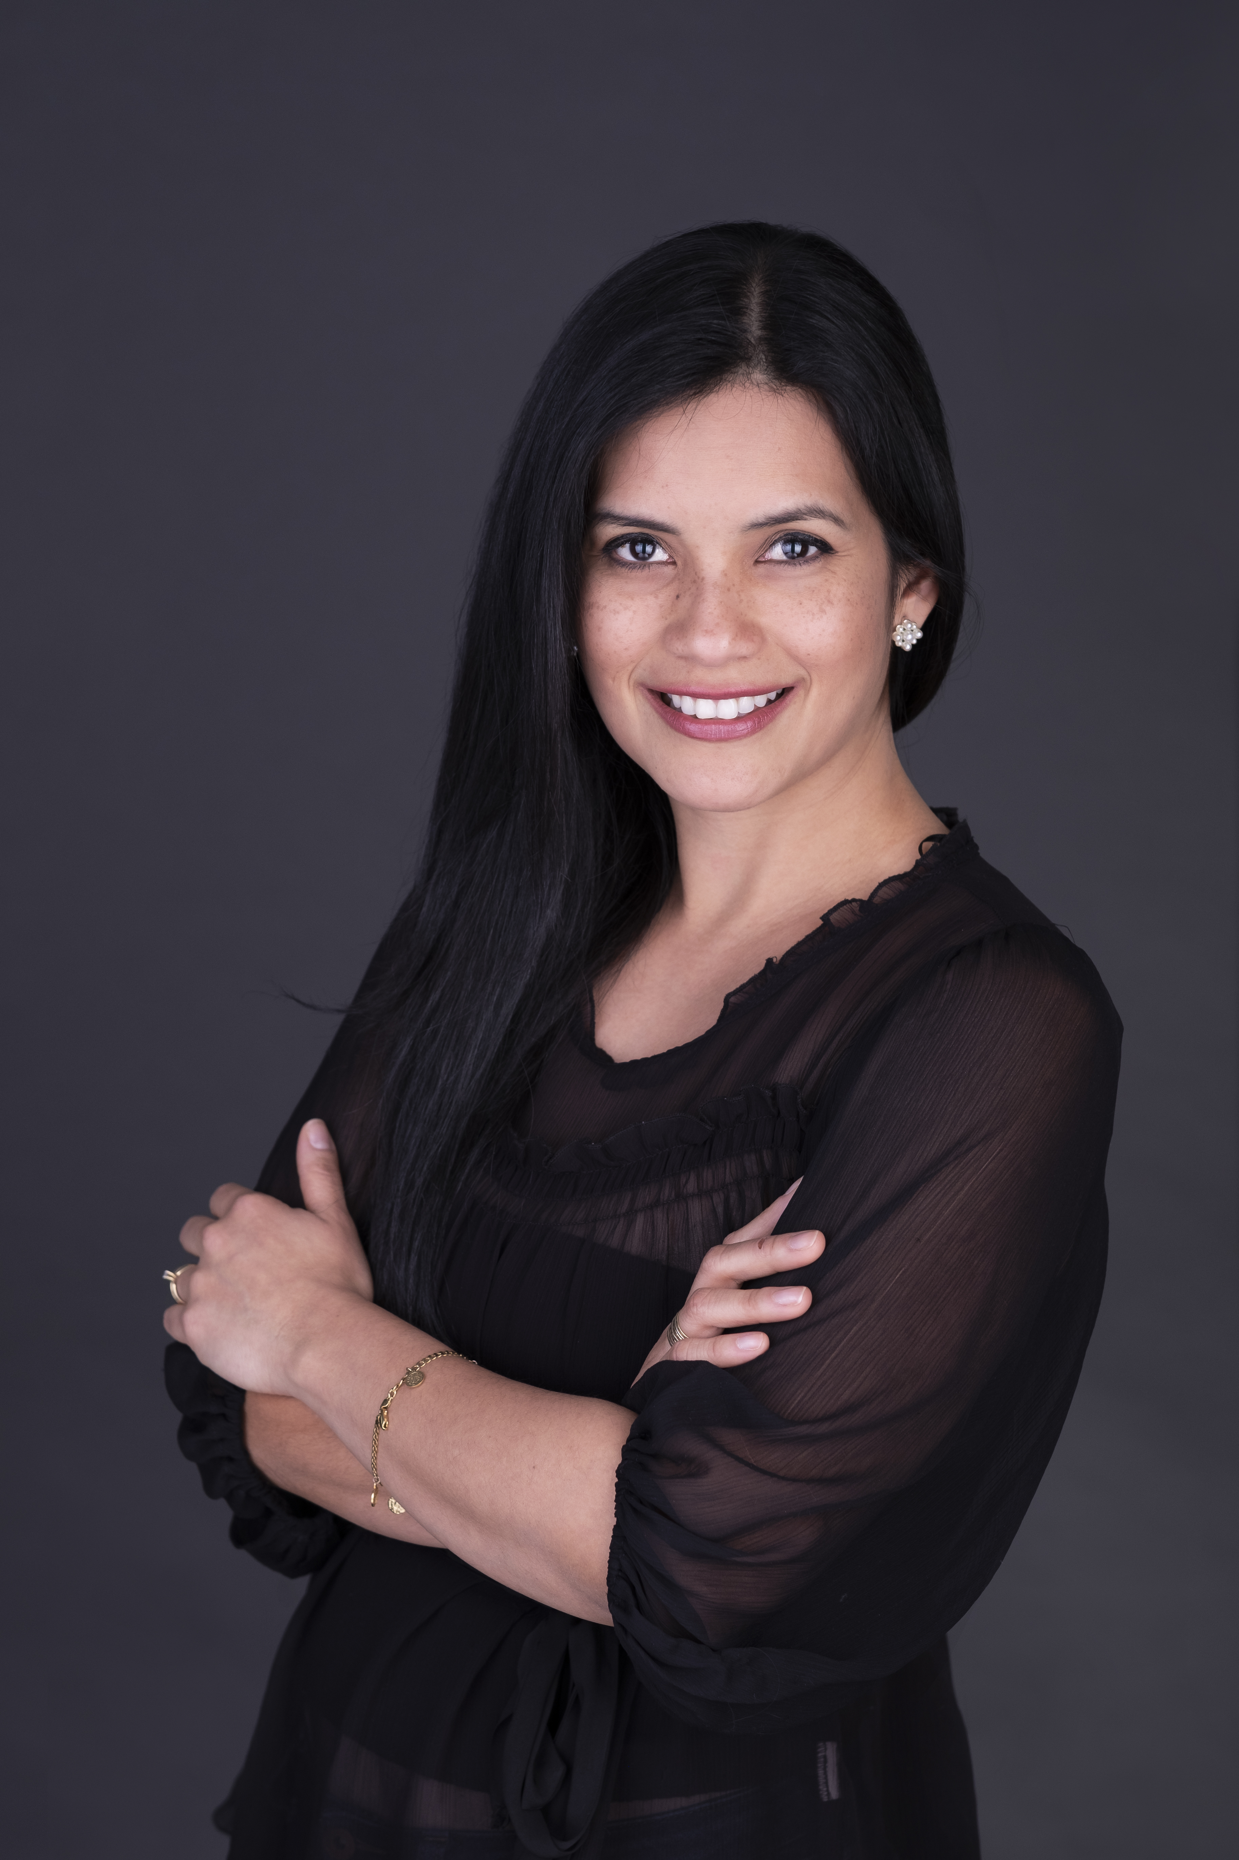
Learn More:
Testimonials and Graduates
"The SR&S Program gave me the confidence to make a lasting impact in my community, while opening up exciting career opportunities. Thanks to this program, I advanced to a leadership role where I can actively contribute to creating a better world.“ Jessica Bermudez, Director Community Engagement
Director Community Engagement,
JA British Columbia
Testimonials: https://www.csr-stmikes.ca/testimonials/
List of Graduates: https://www.csr-stmikes.ca/graduates/

Slide 15
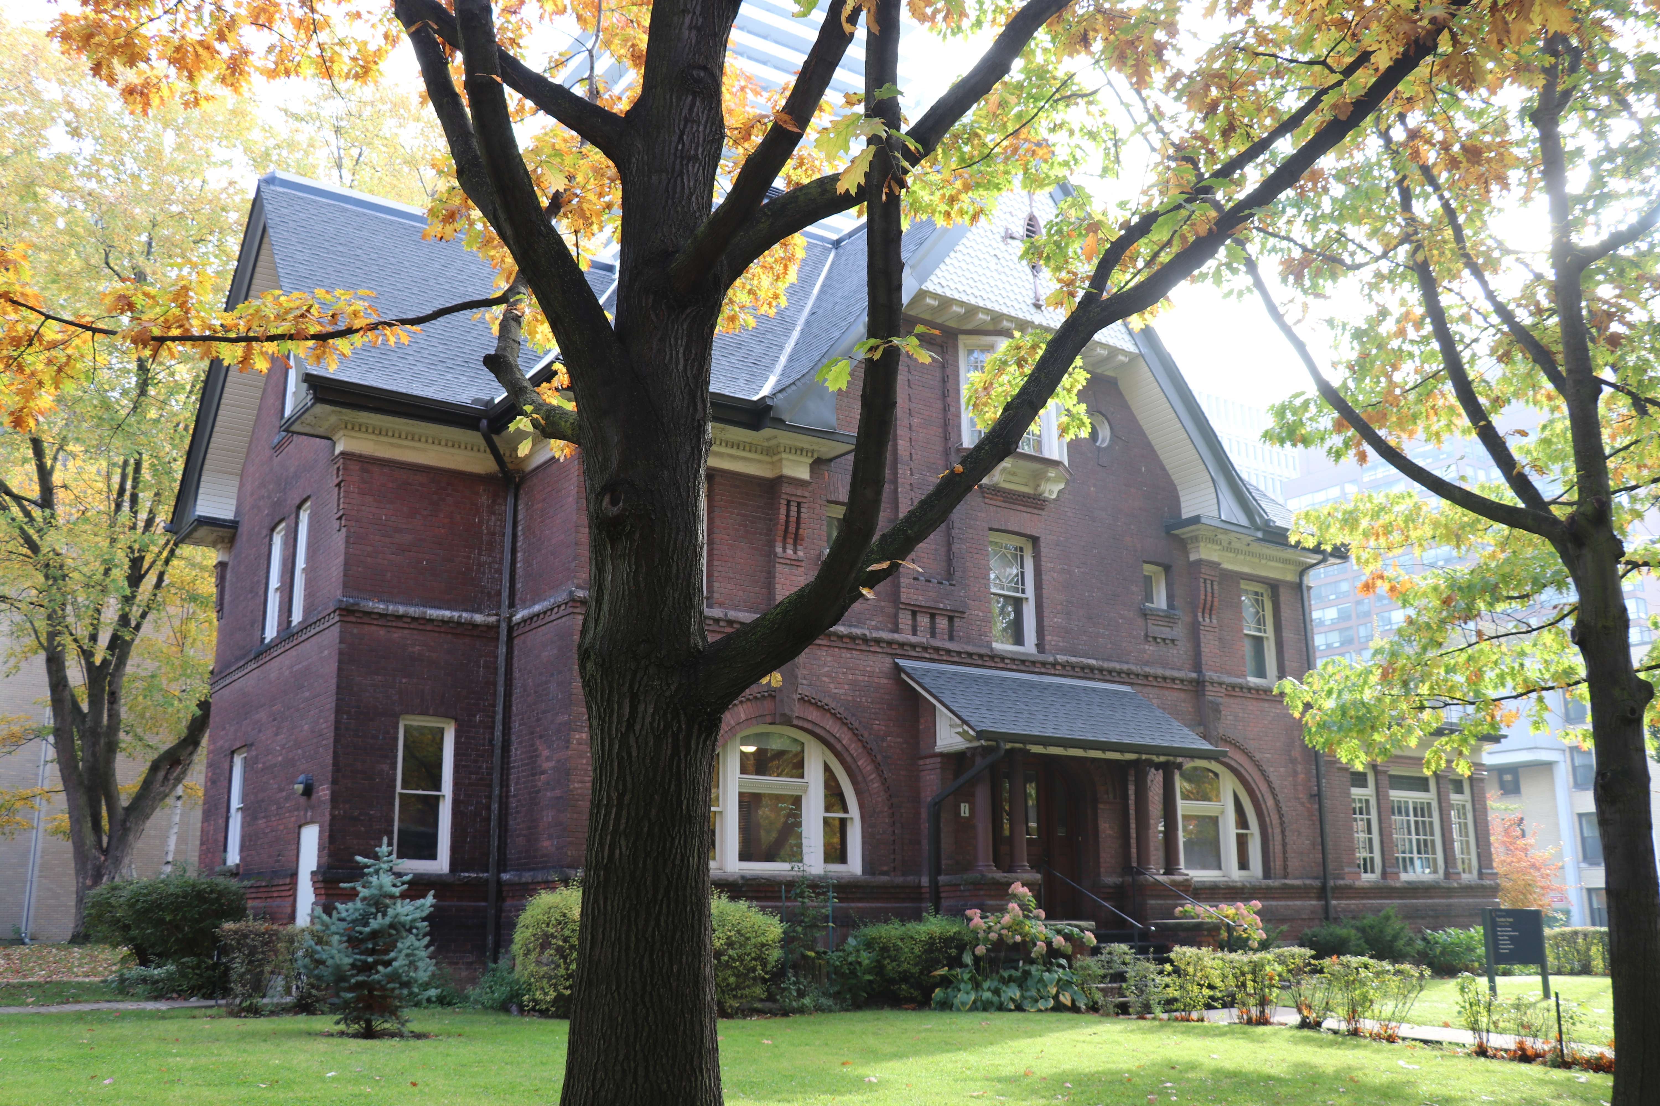
Contact Us:
Kathryn Cooper: kathryncooper@csr-stmikes.ca
Tel: 905-586-0254
Join our Email List: https://lp.constantcontactpages.com/su/czNvzYP/USMCUoT
Linkedin Group:
https://www.linkedin.com/school/social-responsibility-sustainability-program-at-ustmikessrs-in-the-university-of-toronto
Apply Now
  http://csr-stmikes.ca
  Click “Apply Now”
Collegium Retreat | 22 February 2020

